Slide 1
Hacking in society
Annotated Bibliography
GEEN 1203: English Communication III
Professor: Monique Guidicelli Resto
Génesis M. Ojeda Rosa

Slide 2
Arguments
01
The dark web
04
Psychological effects
02
Intellectual capabilities
03
Economic effects
05
Protection and prevention

Slide 3
01
The dark web
The center of hackers and everything illegal

Slide 4
What is a malicious hacker?
Chng, S., Lu, H. Y., A, & Yau, D (2022 January) Hacker types, motivations, and strategies: A comprehensive framework. Computers in Human Behavior Reports. https://www.sciencedirect.com/science/article/pii/S245195882200001
A person that individually or as a group gains unauthorized acess to a data for personal gain.

Slide 5
Hacker types
Microsoft. (2022). What is a cyberattack? Microsoft Security. https://www.microsoft.com/en-us/security/business/security-101/what-is-a-cyberattack
Types
White hat hackers
Gray hat hackers
Black hat hackers
Good intentions
Good/Malicious intentions
Malicious intentions

Slide 6

The clear web
Films Media Group. (2018). Dark web: Fighting cybercrime. Films On Demand. https://fod.infobase.com/PortalPlaylists.aspx?wID=103691&xtid=207055.
The regular internet society uses.
Search engines:
Google
DuckDuckGo

Slide 7

The deep web
Websites can’t be found directly in search engines.
Government, hospitals and pharmacies use this web.
It stores classified and private information.

Slide 8
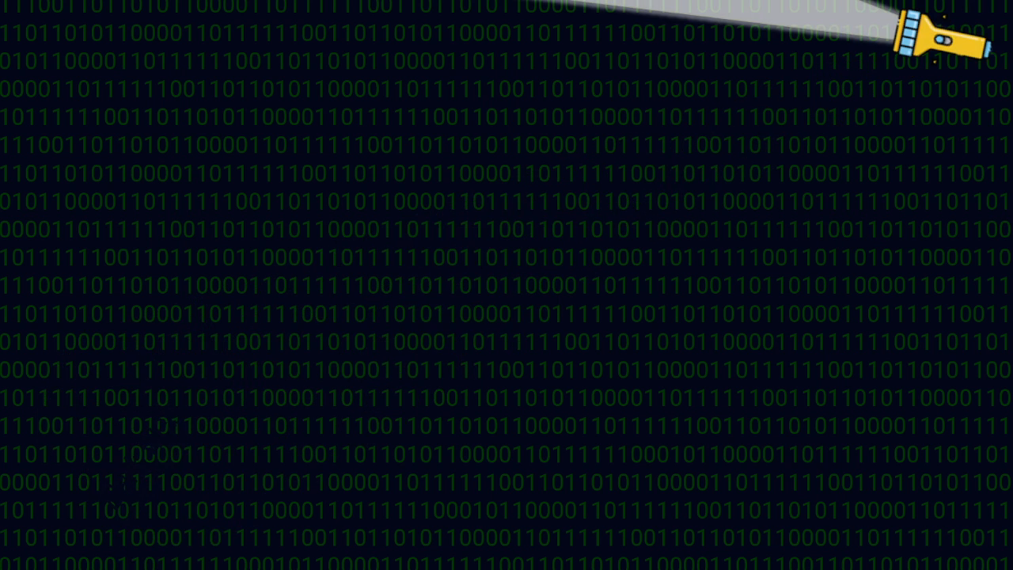
The dark web
Can be accesed by a specific softwares.
Its more anonymus than the other webs.
Illegal market.

Slide 9
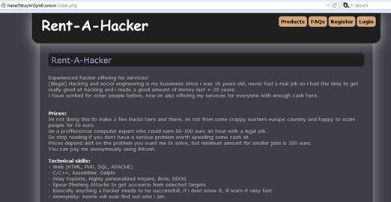
Cybercrime as service
Credit cards
Passwords
Hacking tools
Hacking services
Cryptocurrency

Slide 10
Rent-A-Hacker system
Koyun, A., & Hanabi, E. A. (2017, June 6). Social Engineering Attacks. Isparta; Suleyman Demirel University.
Rosario, F. (2022, May 1). Para largo los problemas del AutoExpreso tras el hackeo. Primera Hora. https://www.primerahora.com/noticias/gobierno-politica/notas/piden-amnistia-en-pago-de-deuda-en-peaje-por-hackeo-en-autoexpreso/
Hacker #1 | Hacker #2 | Hacker #3 | Hacker #4
Malware DDoS | Phishing | Botnet Ransomware | SQL injection attacks Adware

Slide 11
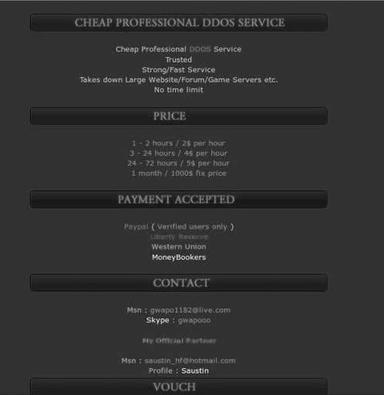
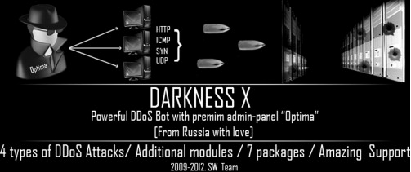
Cybercrime as service

Slide 12
Increasing cybercrime
Demand
Crypto currency
Costs
Cybercrime
Burt, T. (2021). Russian cyberattacks pose greater risk to governments and other insights from our annual report. Microsoft On the Issues. https://blogs.microsoft.com/on-the-issues/2021/10/07/digital-defense-report-2021/
Credentials selling form $1 to $50 each

Slide 13
02
Intellectual capabilities
The mind of a hacker

Slide 14
Componets of a hacker
Summers, Timothy (2013, September 18). How hackers think: A study of cybersecurity experts and their mental models. SSRN. https://papers.ssrn.com/sol3/papers.cfm?abstract_id=2326634
Team work
A
B
Experts in problem solving
C
D
Curiosity and creativity
Fast learners

Slide 15
Hacking methods and types
Research
Hook
Play
Gathering information of the target.
Contact with the target is made.
Execution of the plan.

Slide 16
CITO test final scores
Points obtained from 501 to 550
Schiks, J. A. M., Weijer, S. G. A. van de, &amp; Leukfeldt, E. Rutger (2021, August 18). High tech crime, high intellectual crime? comparing the intellectual capabilities of cybercriminals, traditional criminals, and non-criminals. Computers in Human Behavior. https://www.sciencedirect.com/science/article/pii/S0747563221003083
Cybercriminals
531.29
528.38
Traditional criminals
Non criminals
535.5

Slide 17
03
Economic effects
Everyone is affected

Slide 18
Cyberattack statictics
Live cyber threat map: Check point. (2022) Live Cyber Threat Map | Check Point. (n.d.). https://threatmap.checkpoint.com/
Kaspersky. (2022). Kaspersky cyberthreat real-time map. MAP. https://cybermap.kaspersky.com/
Rosario, F. (2022, May 1). Para largo los problemas del AutoExpreso tras el hackeo. Primera Hora. https://www.primerahora.com/noticias/gobierno-politica/notas/piden-amnistia-en-pago-de-deuda-en-peaje-por-hackeo-en-autoexpreso/
Puerto Rico
01
Most common hacking type is malware.
02
03
Russia
02
01
Is the most attacked country at the moment.
United States
03
Is the third most attacked country at the moment.

Slide 19
$1,141,553
Microsoft. (2022, August 1). Cyberthreat Minute: The scale and scope of worldwide cybercrime in 60 seconds. Security Insider. https://www.microsoft.com/en-us/security/business/security-insider/anatomy-of-an-external-attack-surface/cyberthreat-minute/
Cybercrime cost per minute in the world

Slide 20
$285,388
Cybercrime security spent per minute

Slide 21
04
Psychological effects
The mind of the victim

Slide 22
Reports of cybercrime
Alexa Palassis, A., Craig P. Speelman, C. P., & Julie Ann Pooley, F. (2021, October). An exploration of the psychological impact of hacking victimization. ResearchGate | Find and share research. (PDF) An Exploration of the Psychological Impact of Hacking Victimization (researchgate.net)
?
700,000
^
Reports to the Internet Crime Complait Center
50%
2018
2019
2020
Increase from 2019
:

Slide 23
Victims of hackings may develop
Anxiety
Vunerabilities
Depression
Trust issues
Secondary victimization
Coping strategies

Slide 24
Victims problems
01
02
Work
Social interactions

Slide 25
05
Protection and prevention
Minimizing the crime of hacking

Slide 26
Prevention statistics
99%
20%
21%
Kaspersky, K. (2022, September 30). What is cybercrime? how to protect yourself from Cybercrime. www.kaspersky.com. https://www.kaspersky.com/resource-center/threats/what-is-cybercrime
99% of hacker attacks can be prevented by using two-step authentication
Less than 20% of people use strong authentication features
21% of attacks are directed to consumers

Slide 27
Hacking protection and preventions
Mayer, J. (2021, March 8). Goverment hacking. HeinOnline. https://heinonline.org/HOL/LandingPage?handle=hein.journals%2Fylr127&amp;div=15&amp;id=&amp;page=
Hiring more white hat hackers
Developing more AI’s
Using strong multi-step authentication
Using strong and different passwords for every account

Slide 28
Hacking protection and preventions
Not clicking or downloading suspicious adds, emails or texts
Maintaining the security updates to date and reporting any vulnerability issues.
Not storing passwords in a device
Not using public Wi-Fi or using VPNs

Slide 29
Sources used
Films Media Group. (2018). Dark web: Fighting cybercrime. Films On Demand. https://fod.infobase.com/PortalPlaylists.aspx?wID=103691&xtid=207055.
1
Documentary: Authentic Distribution GmbH
Method: Quantitative and qualitative
Strenghts: Updated, reliable,descriptive uses and photos and videos.
Burt, T. (2021). Russian cyberattacks pose greater risk to governments and other insights from our annual report. Microsoft On the Issues. https://blogs.microsoft.com/on-the-issues/2021/10/07/digital-defense-report-2021/
2
Microsoft: Tom Burt
Method: Quantitative
Strenghts: Updated, reliable and descriptive.
Case Western Reserve University: Timothy C. Summers
Method: Qualitative
Strenghts: Updated, reliable. Conducts an interview and adds tables to represent the data.
Summers, Timothy (2013, September 18). How hackers think: A study of cybersecurity experts and their mental models. SSRN. https://papers.ssrn.com/sol3/papers.cfm?abstract_id=2326634
3

Slide 30
Sources used
Demirel University: Arif Koyun and Ehssan Al Janabi
Method: Quantitative
Strenghts: Updated, reliable, descriptive, and uses comparisons tables and diagrams to represent the data.
Koyun, A., & Hanabi, E. A. (2017, June 6). Social Engineering Attacks. Isparta; Suleyman Demirel University.
4
Netherland institute and The Hague University: Jim Schicks, Steve van de Weijer, Rutger Leufeldt
Method: Quantitative and qualitative
Strenghts: Recent, reliable, descriptive. Conducts an interview shown with tables and graphs.
Schiks, J. A. M., Weijer, S. G. A. van de, &amp; Leukfeldt, E. Rutger (2021, August 18). High tech crime, high intellectual crime? comparing the intellectual capabilities of cybercriminals, traditional criminals, and non-criminals. Computers in Human Behavior. https://www.sciencedirect.com/science/article/pii/S0747563221003083
5
6
Kaspersky: Anti virus company used by goverments and companies
Method: Quantitative
Strenghts: Constantly updated, reliable. Statictics shown in dynamic diagrams and graphs.
Kaspersky. (2022). Kaspersky cyberthreat real-time map. MAP. https://cybermap.kaspersky.com/

Slide 31
Sources used
Alexa Palassis, A., Craig P. Speelman, C. P., & Julie Ann Pooley, F. (2021, October). An exploration of the psychological impact of hacking victimization. ResearchGate | Find and share research. (PDF) An Exploration of the Psychological Impact of Hacking Victimization (researchgate.net)
Sage journals: Alexa Palassis, Craig P. Speelman, Julie Ann Pooley
Method: Qualitative
Strenghts: Recent, reliable and descriptive. It was conducted an interview and shown with a table.
7
Standford University: Johnathan Mayer
Method: Qualitative and qualitative
Strenghts: Recent, reliable and descriptive. Statistics are shown in a graph.
Mayer, J. (2021, March 8). Goverment hacking. HeinOnline. https://heinonline.org/HOL/LandingPage?handle=hein.journals%2Fylr127&amp;div=15&amp;id=&amp;page=
8
Chng, S., Lu, H. Y., A, & Yau, D (2022 January) Hacker types, motivations, and strategies: A comprehensive framework. Computers in Human Behavior Reports. https://www.sciencedirect.com/science/article/pii/S245195882200001
9
Singapore University: Chng S. Lu and Yau
Method: Quantitative
Strenghts: Reliable,descriptive uses tables and statictics

Slide 32
Sources used
Microsoft. (2022). What is a cyberattack? Microsoft Security. https://www.microsoft.com/en-us/security/business/security-101/what-is-a-cyberattack
10
Microsoft: Microsoft academic
Method: Quantitative
Strenghts: Updated, reliable, descriptive.
Check Point: An anti virus that is recognized in all the world.
Method: Quantitative
Strenghts: Constantly updated, reliable, descriptive. Shows statictics in a dynamic way and with tables.
Live cyber threat map: Check point. (2022) Live Cyber Threat Map | Check Point. (n.d.). https://threatmap.checkpoint.com/
11
12
Microsoft: Microsoft academic
Method: Quantitative
Strenghts: Recent, reliable, descriptive. Statictics shown with photos.
Microsoft. (2022, August 1). Cyberthreat Minute: The scale and scope of worldwide cybercrime in 60 seconds. Security Insider. https://www.microsoft.com/en-us/security/business/security-insider/anatomy-of-an-external-attack-surface/cyberthreat-minute/

Slide 33
Sources used
Rosario, F. (2022, May 1). Para largo los problemas del AutoExpreso tras el hackeo. Primera Hora. https://www.primerahora.com/noticias/gobierno-politica/notas/piden-amnistia-en-pago-de-deuda-en-peaje-por-hackeo-en-autoexpreso/
13
Primera Hora: Rosario
Method: Quanlitative
Strenghts: Recent, reliable, descriptive.
Primera Hora. (2022, October 1). ¡cuidado! FBI advierte Sobre Secuestro de Datos en Puerto Rico. Primera Hora. https://www.primerahora.com/noticias/profugos/shows/cuidado-fbi-advierte-sobre-secuestro-de-datos-en-puerto-rico-279377/?utm_medium=Social&amp;utm_source=Facebook#Echobox=1664716790
14
Primera hora: Primer Hora company
Method: Quantitative and qualitative
Strenghts: Recent, reliable.
15
Kasperky: Anti virus company used by goverments and companies Method: Quantitative
Strenghts: Updated, reliable, descriptive.
Kaspersky, K. (2022, September 30). What is cybercrime? how to protect yourself from Cybercrime. www.kaspersky.com. https://www.kaspersky.com/resource-center/threats/what-is-cybercrime

Slide 34
Thanks!
+
Cmd
A
Ctrl
Z
Please keep this slide for attribution
C

